Slide 1

Slide 1
Operation Analytics &
Investigating Metric Spike
Trainity Project 3
Darshani Kirtiwar

Slide 2

Slide 10
PROJECT
DESCRIPTION
The objective of the “Operation Analytics and Investigating Metric spike” project is understanding and explaining changes in key metrics such as a dip in daily user engagement and a drop in sales.
This project is mainly aimed at providing valuable insights using advanced SQL to derive insights from the given data. The end goal is to improve company’s operations and overall profit.
2

Slide 3


Slide 7
35%
CONTENTS:
Case Study 1 : Job Data Analysis
TASKS
A. Jobs Reviewed Over Time
B. Throughput Analysis
C. Language Share Analysis
D. Duplicate Rows Detection
Case Study 2: Investigating Metric Spike
TASKS
A. Weekly User Engagement
B. User Growth Analysis
C. Weekly Retention Analysis
D. Weekly Engagement Per Device
E. Email Engagement Analysis
25%
43%

Slide 4



CASE STUDY 1 : JOB DATA ANALYSIS
TASK : A. JOBS REVIEWED OVER TIME
Objective: Calculate the number of jobs reviewed per hour for each day in November 2020. Your Task: Write an SQL query to calculate the number of jobs reviewed per hour for each day in November 2020.
ANS. SQL Code used for creation of database and the table:
create database operation_project3;
show databases;
use operation_project3;
Create TABLE job_data
(ds DATE,
job_id INT NOT NULL,
actor_id INT NOT NULL,
event VARCHAR(15) NOT NULL,
language VARCHAR(15) NOT NULL,
time_spent INT NOT NULL,
org CHAR(2)
);
SQL code used for calculating number of jobs reviewed per hour for each day.
select * from job_data;
select avg(t) as ‘Avg jobs reviewed per hour each day’ from (select ds, ((count(job_id)*3600/sum(time_spent)) as t
from job_data
where Months(ds) = 11
group by ds) a;
4

Slide 5
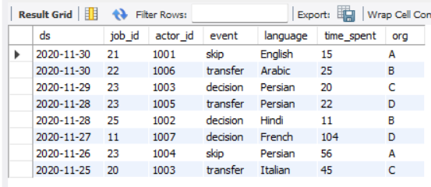
CASE STUDY 1 : JOB DATA ANALYSIS
Created Data Table in SQL : job_data
5

Slide 6
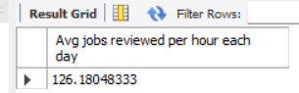
CASE STUDY 1 : JOB DATA ANALYSIS
Output obtained in MySQL workbench
Key Observation Number of jobs reviewed per hour each day:
From the above output obtained we can conclude that the Average number of jobs reviewed per hour for each day is 126 hours (One hundred and twenty six hours).
6

Slide 7
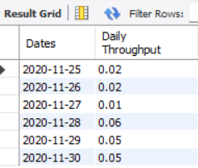

CASE STUDY 1 : JOB DATA ANALYSIS
TASK B. THROUGHPUT ANALYSIS
Objective: Calculate the 7-day rolling average of throughput (number of events per second).
Your Task: Write an SQL query to calculate the 7-day rolling average of throughput. Additionally, explain whether you prefer using the daily metric or the 7-day rolling average for throughput, and why.
ANS. SQL Code used:
SELECT ROUND(COUNT(event)/SUM(time_spent), 2) AS ‘Weekly Throughput’ FROM job_data;
Output :
SELECT ds AS Dates, ROUND(COUNT(event)/SUM(time_spent), 2) AS ‘Daily Throughput’
FROM job_data
GROUP BY ds
ORDER BY ds;
Output:
7

Slide 8
CASE STUDY 1 : JOB DATA ANALYSIS
Key Observation from Throughput Analysis
Throughput means the amount of a product or service that a company can produce and deliver to a client within a specified period. It is the heartbeat of a system, reflecting its health and robustness. In order to meet the increasing demand, we need to improve our throughput. Throughput is an important metric for businesses to keep track of the work and to improve it.
The Weekly throughput, also known as the 7-day rolling average, in this project shows us the events taking place per week. The obtained output in this case is 0.03
The Daily throughput shows various values through each day of the week.
After further analysis, we have come to know that most of the values of the daily throughput are similar or very close to the weekly throughput. From this, we can conclude that Weekly throughput can be considered for regular analysis, as it is convenient to use in the long run. Daily throughput, on the other hand, is good to find out any fault if any major difference in the earnings or cost of production has occurred.
8

Slide 9
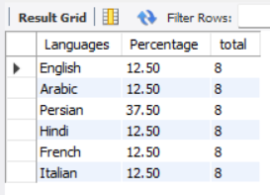
CASE STUDY 1 : JOB DATA ANALYSIS
TASK : C. LANGUAGE SHARE ANALYSIS
Objective: Calculate the percentage share of each language in the last 30 days.
Your Task: Write an SQL query to calculate the percentage share of each language over the last 30 days.
ANS. SQL code used:
SELECT language AS Languages, ROUND(100* COUNT(*)/total, 2) AS Percentage, sub.total
FROM job_data
CROSS JOIN (SELECT COUNT(*) AS total FROM job_data) AS sub
GROUP BY language, sub.total;
Output:
9

Slide 10
CASE STUDY 1 : JOB DATA ANALYSIS
Key Observation from Language Share Analysis
In the given data, there are six languages, namely, English, Arabic, Persian, Hindi, French and Italian. The percentage share of each language over the last 30 days is as follows:
Language | Percentage share (%)
English | 12.5%
Arabic | 12.5%
Persian | 37.5%
Hindi | 12.5%
French | 12.5%
Italian | 12.5%
From the above table, we can observe that, all the other five languages (English, Arabic, Hindi, French and Italian) have a percentage share of 12.5%, while only the Persian language has the maximum share of 37.5%. Hence from the analysis we can conclude, Persian is the most widely used language in the last 30 days.
10

Slide 11

CASE STUDY 1 : JOB DATA ANALYSIS
TASK D. DUPLICATE ROWS DETECTION
Objective: Identify duplicate rows in the data.
Your Task: Write an SQL query to display duplicate rows from the job_data table.
ANS. SQL code used:
SELECT actor_id, COUNT(*) AS Duplicates FROM job_data
GROUP BY actor_id HAVING COUNT(*) > 1;
Output:
11

Slide 12
CASE STUDY 1 : JOB DATA ANALYSIS
Key Observation from Duplicate Rows Detection
From the obtained output in the SQL Workbench, we can observe that there are two duplicate rows in the data. The row with actor id as 1003 is repeated and appears twice in the table. Hence, by using SQL we can detect duplicate rows within any given data.
12

Slide 13
Case Study 2: Investigating Metric Spike
IMPORTING DATA IN SQL
ANS. The dataset given by Trainity had three csv files, users, events and email_events.
SQL code used:
Use operation_project3;
#Table 1 users
CREATE TABLE users;
user_id INT;
Created_at VARCHAR(100)
Company_id INT,
lang VARCHAR(70),
activated_at VARCHAR(100),
state VARCHAR(60) );
SHOW VARIABLES LIKE 'SECURE_FILE_PRIV’;
LOAD DATA INFILE "C:/ProgramData/MySQL/MySQL Server 8.0/Uploads/users.csv"
INTO TABLE users
FIELDS TERMINATED BY ','
OPTIONALLY ENCLOSED BY '"'
LINES TERMINATED BY '\r\n'
IGNORE 1 ROWS;
SELECT * FROM users;
-------# add temporary column temp_created_at----
ALTER TABLE users add column temp_created_at datetime;
#-----add data to the temporary column-----
SET SQL_SAFE_UPDATES = 0;
UPDATE users SET temp_created_at = STR_TO_DATE(created_at, '%d-%m-%Y %H:%i');
SET SQL_SAFE_UPDATES = 1;
13

Slide 14
Case Study 2: Investigating Metric Spike
SQL code used (continued):
#-----change column name from temp_created_at to created_at------
ALTER TABLE users DROP COLUMN created_at;
ALTER TABLE users CHANGE COLUMN temp_created_at created_at DATETIME;
#####Table 2 Events-------
CREATE TABLE events(
user_id INT,
occurred_at VARCHAR(100),
event_type VARCHAR(50),
event_name VARCHAR(100),
location VARCHAR(50),
device VARCHAR(50),
user_type int
);
LOAD DATA INFILE "C:/ProgramData/MySQL/MySQL Server 8.0/Uploads/events.csv"
INTO TABLE events
FIELDS TERMINATED BY ','
OPTIONALLY ENCLOSED BY '"'
LINES TERMINATED BY '\r\n'
IGNORE 1 ROWS;
SELECT * FROM events;
-------# add temporary column temp_created_at------
ALTER TABLE events add column temp_occurred_at datetime;
#-----add data to the temporary column-----
SET SQL_SAFE_UPDATES = 0;
UPDATE events SET temp_occurred_at = STR_TO_DATE(occurred_at, '%d-%m-%Y %H:%i’);
SET SQL_SAFE_UPDATES = 1;
#-----change column name from temp_created_at to created_at------
14

Slide 15
Case Study 2: Investigating Metric Spike
SQL code used (continued):
ALTER TABLE events DROP COLUMN occurred_at;
ALTER TABLE events CHANGE COLUMN temp_occurred_at occurred_at DATETIME;
#####Table 3 email_events-----
CREATE TABLE email_events(
user_id INT,
occurred_at VARCHAR(100),
action VARCHAR(100),
user_type INT );
LOAD DATA INFILE "C:/ProgramData/MySQL/MySQL Server 8.0/Uploads/email_events.csv"
INTO TABLE email_events
FIELDS TERMINATED BY ','
OPTIONALLY ENCLOSED BY '"'
LINES TERMINATED BY '\r\n'
IGNORE 1 ROWS;
SELECT * FROM email_events;
-------# add temporary column temp_created_at------
ALTER TABLE email_events add column temp_occurred_at datetime;
#-----add data to the temporary column-----
SET SQL_SAFE_UPDATES = 0;
UPDATE email_events SET temp_occurred_at = STR_TO_DATE(occurred_at, '%d-%m-%Y %H:%i');
SET SQL_SAFE_UPDATES = 1;
#-----change column name from temp_created_at to created_at------
ALTER TABLE email_events DROP COLUMN occurred_at;
ALTER TABLE email_events CHANGE COLUMN temp_occurred_at occurred_at DATETIME;
15

Slide 16
Case Study 2: Investigating Metric Spike
TASK A. WEEKLY USER ENGAGEMENT
Objective: Measure the activeness of users on a weekly basis.
Your Task: Write an SQL query to calculate the weekly user engagement.
ANS. SQL CODE used:
Select EXTRACT(WEEK FROM occurred_at) AS week_num,
COUNT(DISTINCT user_id) AS active_users
FROM events
WHERE event_type = 'engagement’
GROUP BY week_num
ORDER BY week_num;
16

Slide 17
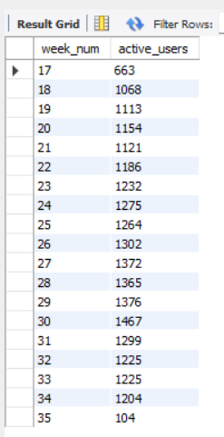
Case Study 2: Investigating Metric Spike
OUTPUT IN MySQL Workbench
In the output obtained, we can observe that various weeks have different amount of active users.
17

Slide 18
Case Study 2: Investigating Metric Spike
Key Observations from Weekly user engagement
From the table, the week number 30 has maximum number of active users which is 1,467. It can indicate that any marketing campaign might have increased the user engagement. On the other hand, week no. 35 has least amount of active users, this might indicate that the impact of previous campaign started decreasing and the company needs to improve it’s user engagement.
In this way, analysing active users per week can help the company to find out innovative ways to keep the users engaged and also increase the amount of active users.
18

Slide 19
Case Study 2: Investigating Metric Spike
TASK B. User Growth Analysis
Objective: Analyze the growth of users over time for a product.
Your Task: Write an SQL query to calculate the user growth for the product.
ANS. SQL CODE used:
#Task User Growth Analysis
SELECT COUNT(*) FROM users
WHERE state = 'active';
SELECT DISTINCT state FROM users;
WITH weekly_active_users AS (
SELECT
EXTRACT(YEAR FROM created_at) AS year,
EXTRACT(WEEK FROM created_at) AS week_number,
COUNT(DISTINCT user_id) AS num_users
FROM users
GROUP BY year, week_number
)
SELECT year, week_number, num_users,
SUM(num_users) OVER (ORDER BY year, week_number) AS cumulative_users
FROM weekly_active_users
ORDER BY year, week_number;
19

Slide 20
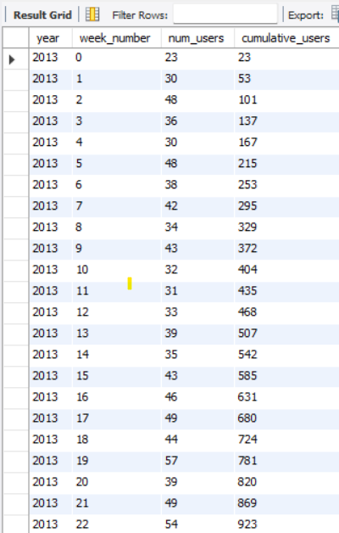
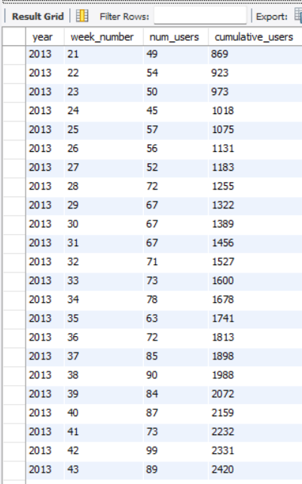
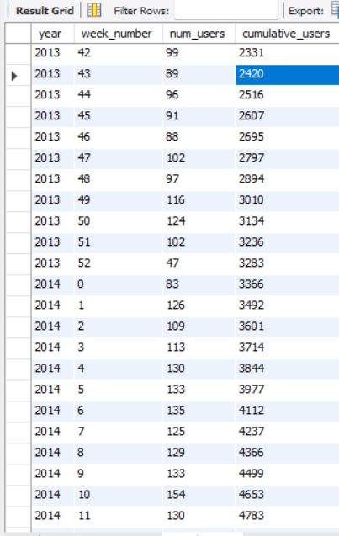
Case Study 2: Investigating Metric Spike
OUTPUT IN MySQL Workbench
20

Slide 21
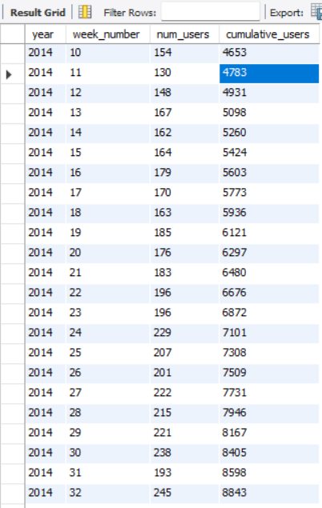
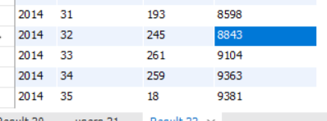
Case Study 2: Investigating Metric Spike
OUTPUT IN MySQL Workbench
21

Slide 22
Case Study 2: Investigating Metric Spike
Key Observations from User Growth Analysis
From the output obtained, we can see that there are four columns, namely, year, week number, number of users, and cumulative users. After observing the output tables generated in MySQL Workbench, it is observed that various weeks have different amounts of new users, and in each week, the total number of users keeps increasing.
For example, in week 0 (zero), which is the starting week and is in the year 2013, we have only 23 users, but at the end of the output table, where it is week 35 and year 2014, we have a total of 9381 users. This shows an outstanding amount of growth in the total number of users.
It must be further taken into consideration that with the total number of users, the company must also focus on the weekly growth in the number of users. We can observe that week 33 of the year 2014 has the maximum number of new users, which is 261. The company must closely observe the steps taken in that period of time and must keep in mind the strategy necessary to increase incoming new users. We can also notice that in week 35 of the year 2014, there were just 18 new users; it is just two weeks after the maximum number of incoming users was achieved. The company can find various ways to increase the user inflow by observing this analysis. It also helps the marketing department to analyse which steps taken by them were the most effective in increasing the user count. In this way, with the help of data analysis, the company can always stay ahead in the competition.
22

Slide 23
Case Study 2: Investigating Metric Spike
TASK C. Weekly Retention Analysis
Objective: Analyze the retention of users on a weekly basis after signing up for a product.
Your Task: Write an SQL query to calculate the weekly retention of users based on their sign-up cohort.
ANS. SQL CODE used:
SELECT
first AS "week_number",
SUM(CASE WHEN week_number = 0 THEN 1 ELSE 0 END) AS "week_0",
SUM(CASE WHEN week_number = 1 THEN 1 ELSE 0 END) AS "week_1", …….# same way upto week 18-----
SUM(CASE WHEN week_number = 18 THEN 1 ELSE 0 END) AS "week_18“
FROM (
SELECT m.user_id,
m.login_week,
n.first,
m.login_week - n.first AS week_number
FROM (
SELECT
user_id,
EXTRACT(WEEK FROM occurred_at) AS login_week
FROM events
GROUP BY user_id, login_week
) m
JOIN (
SELECT user_id,
EXTRACT(WEEK FROM occurred_at) AS
Login_week
FROM events
GROUP BY user_id, login_week
) m
23

Slide 24
Case Study 2: Investigating Metric Spike
TASK C. Weekly Retention Analysis
Objective: Analyze the retention of users on a weekly basis after signing up for a product.
Your Task: Write an SQL query to calculate the weekly retention of users based on their sign-up cohort.
ANS. SQL CODE used:
JOIN (
SELECT user_id,
MIN(EXTRACT(WEEK FROM occurred_at)) AS first
FROM events
GROUP BY
user_id
) n
On m.user_id = n.user_id
GROUP BY first
ORDER BY first;
Output :
A screenshot of the output obtained in MySQL Workbench is shown in the next slide
24

Slide 25
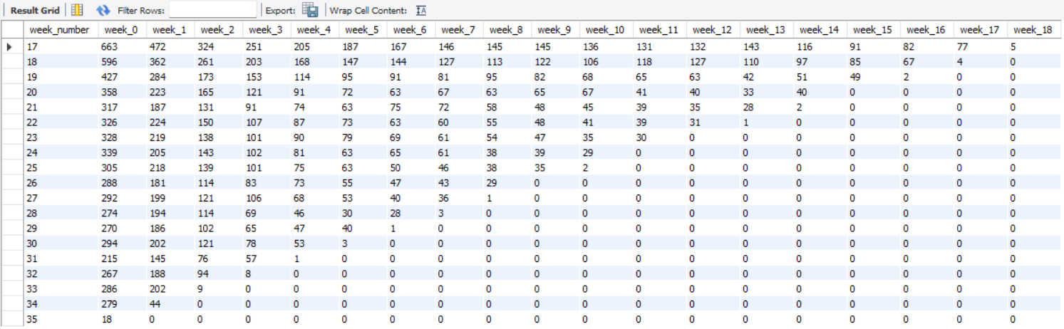

Slide 26
Case Study 2: Investigating Metric Spike
Key Observation from Weekly Retention Analysis
From the table generated in the MySQL Workbench, we can observe :
The first column shows the week number and the second column shows the week when the number of users sign-up for the first time. It is their zeroth week as a user. We have analysed the users for almost eighteen weeks since their sign-up. In every passing week we can observe that the user engagement is gradually reducing.
This shows that more strategies must be planned in order to keep the users engaged. This analysis helps us to get deep insights into the user pattern.
It can be taken into consideration that as the users cross a certain amount of time being as users, they tend to reduce their usage. This analysis can be prove to be an alarm for any company which needs to gear up it’s marketing game. The company must focus not only on bringing new users but also retain the existing users.
;
26

Slide 27
Case Study 2: Investigating Metric Spike
TASK D. Weekly Engagement Per Device
Objective: Measure the activeness of users on a weekly basis per device.
Your Task: Write an SQL query to calculate the weekly engagement per device.
ANS. SQL CODE used:
SELECT
EXTRACT(WEEK FROM occurred_at) AS week_number,
COUNT(DISTINCT CASE WHEN device = 'dell inspiron notebook' THEN user_id ELSE NULL END) AS dell_inspiron_notebook,
COUNT(DISTINCT CASE WHEN device = 'iphone 5' THEN user_id ELSE NULL END) AS iphone_5,
COUNT(DISTINCT CASE WHEN device = 'iphone 4s' THEN user_id ELSE NULL END) AS iphone_4s,
COUNT(DISTINCT CASE WHEN device = 'iphone 5s' THEN user_id ELSE NULL END) AS iphone_5s,
COUNT(DISTINCT CASE WHEN device = 'ipad air' THEN user_id ELSE NULL END) AS ipad_air,
COUNT(DISTINCT CASE WHEN device = 'windows surface' THEN user_id ELSE NULL END) AS windows_surface,
COUNT(DISTINCT CASE WHEN device = 'macbook air' THEN user_id ELSE NULL END) AS macbook_air,
COUNT(DISTINCT CASE WHEN device = 'macbook pro' THEN user_id ELSE NULL END) AS macbook_pro,
COUNT(DISTINCT CASE WHEN device = 'ipad mini' THEN user_id ELSE NULL END) AS ipad_mini,
COUNT(DISTINCT CASE WHEN device = 'kindle fire' THEN user_id ELSE NULL END) AS kindle_fire,
COUNT(DISTINCT CASE WHEN device = 'amazon fire phone' THEN user_id ELSE NULL END) AS amazon_fire_phone,
27

Slide 28
Case Study 2: Investigating Metric Spike
TASK D. Weekly Engagement Per Device
Objective: Measure the activeness of users on a weekly basis per device.
Your Task: Write an SQL query to calculate the weekly engagement per device.
ANS. SQL CODE used:
COUNT(DISTINCT CASE WHEN device = 'nexus 5' THEN user_id ELSE NULL END) AS nexus_5,
COUNT(DISTINCT CASE WHEN device = 'nexus 7' THEN user_id ELSE NULL END) AS nexus_7,
COUNT(DISTINCT CASE WHEN device = 'nexus 10' THEN user_id ELSE NULL END) AS nexus_10,
COUNT(DISTINCT CASE WHEN device = 'samsung galaxy s4' THEN user_id ELSE NULL END) AS samsung_galaxy_s4,
COUNT(DISTINCT CASE WHEN device = 'samsung galaxy tablet' THEN user_id ELSE NULL END) AS samsung_galaxy_tablet,
COUNT(DISTINCT CASE WHEN device = 'samsung galaxy note' THEN user_id ELSE NULL END) AS samsung_galaxy_note,
COUNT(DISTINCT CASE WHEN device = 'lenovo thinkpad' THEN user_id ELSE NULL END) AS lenovo_thinkpad,
COUNT(DISTINCT CASE WHEN device = 'acer aspire notebook' THEN user_id ELSE NULL END) AS acer_aspire_notebook,
COUNT(DISTINCT CASE WHEN device = 'asus chromebook' THEN user_id ELSE NULL END) AS asus_chromebook,
28

Slide 29
Case Study 2: Investigating Metric Spike
TASK D. Weekly Engagement Per Device
Objective: Measure the activeness of users on a weekly basis per device.
Your Task: Write an SQL query to calculate the weekly engagement per device.
ANS. SQL CODE used:
COUNT(DISTINCT CASE WHEN device = 'htc one' THEN user_id ELSE NULL END) AS htc_one,
COUNT(DISTINCT CASE WHEN device = 'nokia lumia 635' THEN user_id ELSE NULL END) AS nokia_lumia_635,
COUNT(DISTINCT CASE WHEN device = 'mac mini' THEN user_id ELSE NULL END) AS mac_mini,
COUNT(DISTINCT CASE WHEN device = 'hp pavilion desktop' THEN user_id ELSE NULL END) AS hp_pavilion_desktop,
COUNT(DISTINCT CASE WHEN device = 'dell inspiron desktop' THEN user_id ELSE NULL END) AS dell_inspiron_desktop
FROM events
WHERE event_type = 'engagement'
GROUP BY week_number
ORDER BY week_number;
29

Slide 30
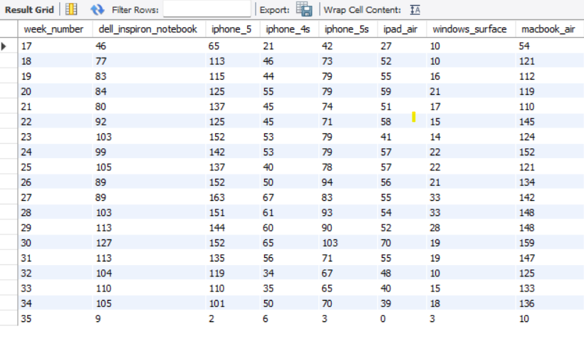
Case Study 2: Investigating Metric Spike
OUTPUT IN MySQL Workbench
30

Slide 31
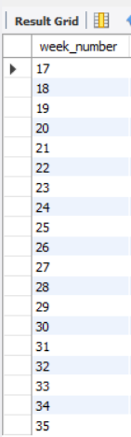
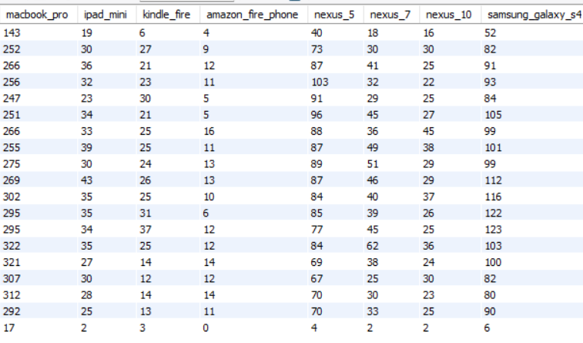
Case Study 2: Investigating Metric Spike
OUTPUT IN MySQL Workbench
31

Slide 32
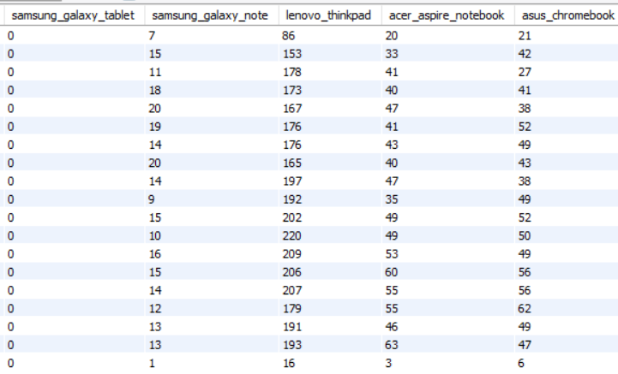
Case Study 2: Investigating Metric Spike
OUTPUT IN MySQL Workbench
32

Slide 33
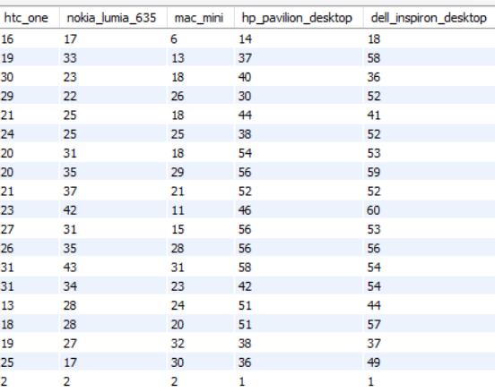
Case Study 2: Investigating Metric Spike
OUTPUT IN MySQL Workbench
33

Slide 34

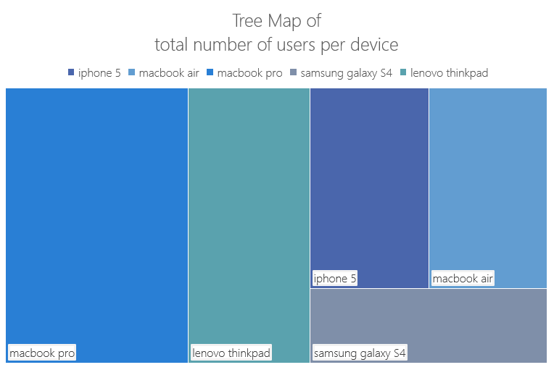
Case Study 2: Investigating Metric Spike
Key Observation from Weekly Engagement Per Device
Users per device
34

Slide 35
Case Study 2: Investigating Metric Spike
Key Observation from Weekly Engagement Per Device
The output obtained in result section of MySQL Workbench shows the active users per device per week. From week 17 to week 35, various devices are listed. All the devices have different amount of users per week. Among all these devices we can observe the top five devices which are used frequently. The Tree map in the previous slide shows us the top five devices which have the highest number of users. The table below shows the data about the sum total number of users in all the weeks for top five devices.
From the table it can be observed that Macbook pro has the highest amount of users, Lenovo thinkpad has second highest followed by iPhone 5, MacBook air and Samsung galaxy S4.
This analysis helps us to understand the most used devices. The company can bring more interesting features and offers for the particular device users which are present in majority. We can see that Macbook Pro has the highest amount of users and the company needs to focus on them to increase the user engagement and also increase new users.
Device Name | Total number of users in all the weeks
Iphone 5 | 2340
Macbook air | 2340
Macbook pro | 4943
Samsung galaxy S4 | 1740
Lenovo thinkpad | 3286
35

Slide 36
Case Study 2: Investigating Metric Spike
TASK E. Email Engagement Analysis
Objective: Analyze how users are engaging with the email service..
Your Task: Write an SQL query to calculate the email engagement metrics.
ANS. SQL CODE used:
SELECT
100.0 * SUM(CASE WHEN email_action = 'email_open' THEN 1 ELSE 0 END) /
SUM(CASE WHEN email_action = 'email_sent' THEN 1 ELSE 0 END) AS email_open_rate,
100.0 * SUM(CASE WHEN email_action = 'email_clicked' THEN 1 ELSE 0 END) /
SUM(CASE WHEN email_action = 'email_sent' THEN 1 ELSE 0 END) AS email_clicked_rate
FROM
(SELECT *,
CASE
WHEN action IN ('sent_weekly_digest', 'sent_reengagement_email') THEN 'email_sent'
36

Slide 37
Case Study 2: Investigating Metric Spike
TASK E. Email Engagement Analysis
Objective: Analyze how users are engaging with the email service..
Your Task: Write an SQL query to calculate the email engagement metrics.
ANS. SQL CODE used:
WHEN action IN ('email_open') THEN 'email_open'
WHEN action IN ('email_clickthrough') THEN 'email_clicked'
ELSE NULL
END AS email_action
FROM
operation_project3.email_events
) a;
37

Slide 38
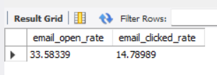
Case Study 2: Investigating Metric Spike
OUTPUT IN MySQL Workbench
Output:
Email open rate = 33.5%
Email clicked rate = 14.7%
38

Slide 39
Case Study 2: Investigating Metric Spike
Key Observation from Email Engagement Analysis
In Email engagement analysis we calculate email open rate which is 33.58 % and email click rate which is 14.78 %.
Email opens, trach when recipients load images in an email, indicating they have at least seen the message while Emai Clicks measure when recipients actively click on links within the email, demonstrating deeper engagement and interest in the content. Opens provide insight into the effectiveness of subject lines and sender information, while clicks reveal the appeal of the actual content, offers and calls-to-action within the email. Email clicks become more valuable metric since they indicate which users successfully took further efforts and were more engaged in the content of the email.
39

Slide 40
Project 3: Operation Analytics and Investigating Metric Spike
APPROACH
After studying MySQL course from Trainity. I learnt how to import large dataset into MySQL. There were two case studies Job data analysis and Investigating metric spike. For both the cases two different datasets were provided. First dataset was easy to import but second dataset had three files namely, users, events, email events. These files had large amount of data. I used various techniques taught in the course to import the whole data. I used MS Excel to view the CSV files. In this way, I could get clarity about the contents of the data. It was interesting to work on such huge amount of data for the first time.
40

Slide 41




Project 3: Operation Analytics and Investigating Metric Spike
Tech-stack Used
MySQL Workbench 8.0 CE
MS Excel
MS PowerPoint
Google Drive
Trainity Website
Google Chrome
41

Slide 42
Slide 5
DATA DRIVEN INSIGHTS for Case Study 1
TIME MANAGEMENT
EMPLOYEMENTS
TEAM CONNECTION
Jobs reviewed per hour
is 126 hours.
7-day rolling average
Was 0.03 events per
second.
The first dataset
contained a list of
Actor IDs and the
languages used by
them. It also contained some duplicate rows which needed to be found out in MySQL.
Persian was the most highly used language
Within the list of
Persons. All other languages had a use percentage of 12.5 % while
Persian usage was
37.5 %
42

Slide 43
Slide 6
DATA DRIVEN for Case Study 2
1467
Year
Week
Users
Weekly Retention Analysis
The weekly retention analysis
Highlights the need to retain the existing customers.
2013
1
23
Weekly User
Engagement
2014
35
9381
User Growth Analysis
Email open rate = 33.5 %
Email click rate = 14.78 %
Weekly Engagement
Per Device
Email Engagement Analysis
MacBook Pro is the highest
Used device among the
List of Users.
4943
43

Slide 44
Project 3: Operation Analytics and Investigating Metric Spike
RESULT
The “Operation Analytics and Investigating Metric Spike” project has helped me to gain hands-on experience in various important skills, such as importing a huge dataset in MySQL Workbench. This project has helped me to understand the use of queries in SQL. The use of creating a database and then sorting the data into various tables helps to clean the data. Data cleaning is a very important step in Data Analysis. It helps us to neatly organise the data. This organised data can then be used to find out certain valuable hidden insights in the collected raw data.
In the first case study, the amount of data was small, but this case study was mainly focused on the time management aspect of a company.
44

Slide 45
Project 3: Operation Analytics and Investigating Metric Spike
RESULT
The jobs reviewed per hour and 7-day rolling average show the amount of work being done per hour. This can be useful to understand the current rate at which work is being done and identify further improvements needed. The percentage of languages used gives us important insight into the communication process of the employees, which can help increase employee satisfaction. This case study also prompts to find out duplicate rows in the data, as the data might not always be properly cleaned and sorted.
45

Slide 46
Project 3: Operation Analytics and Investigating Metric Spike
RESULT
In the second case study, the users’ data is given. It mainly focuses on finding out insights such as Weekly User Engagement, for measuring activeness of a user on a weekly basis. We also find out the growth of users overtime and weekly retention of users is necessary to find out how many users the company is able to retain The weekly engagement per device metric helps to find out the device majorly used by the users. Email engagement analysis gives insight into how users are engaging with the email service.
46

Slide 47
Project 3: Operation Analytics and Investigating Metric Spike
RESULT
For me, the most challenging part of the project was to change the datetime format of the given data. Eventually, I was able to find out the process with the help of which the datetime format was converted into the date and time format accepted by SQL. Firstly, I had to create a temporary column, then put criteria for the format of date and time, and then again insert the correctly obtained data into the existing datetime column. This process felt hard at first but after repeating it for other tables, I found it to be a very useful skill to have been learnt.
47

Slide 48


Slide 11
THANK YOU

